Slide 1
Data Structures & Algorithms (CSC-214)
Stack

Slide 2
Stack
A stack is a special kind of list
Insertion and deletions takes place at one end called top
Other names
Push down list
Last In First Out (LIFO)
Examples
Books on floor
Dishes on a shelf

Slide 3
Stack ADT
Stack ADT emphasizes specific operations
Uses an explicit linear ordering
Insertions and removals are performed individually
Inserted objects are pushed onto the stack
Top of the stack is the most recent object pushed onto the stack
When an object is popped from the stack, the current top is erased

Slide 4
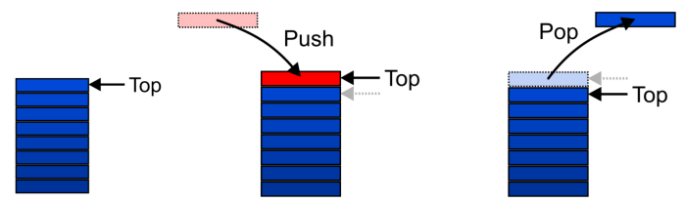
Stack ADT – Operations (1)
Graphically, the stack operations are viewed as follows:

Slide 5
Stack ADT – Operations (2)
MAKENULL(S): Make Stack S be an empty stack
TOP(S): Return the element at the top of stack S
POP(S): Remove the top element of the stack
PUSH(S,x): Insert the element x at the top of the stack
EMPTY(S): Return true if S is an empty stack and return false otherwise

Slide 6
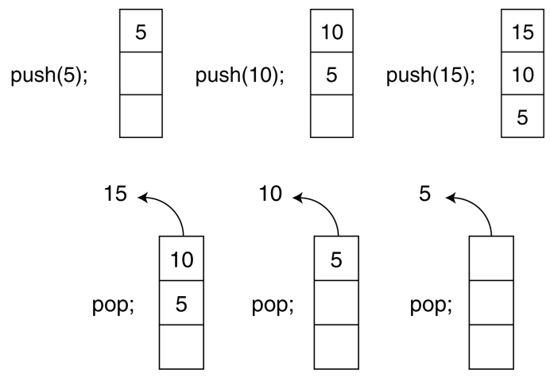
Push and Pop Operations of Stack

Slide 7
Applications (1)
Many applications
Parsing code
Matching parenthesis
Tracking function calls
Dealing with undo/redo operations
The stack is a very simple data structure
Given any problem, if it is possible to use a stack, this significantly simplifies the solution

Slide 8
Use of Stack in Function Calls (1)
When a function begins execution an activation record (call stack) is created to store the current execution environment for that function
Activation records all the necessary information about a function call, including
Parameters passed by the caller function
Local variables
(Callee) Function’s return value(s)
Return address of the caller function
Address of instruction following the function call
Without activation records, the program wouldn’t be able to "pause" one function and "jump into" another.

Slide 9
Use of Stack in Function Calls (2)
Each invocation of a function has its own activation record
Recursive/Multiple calls to the functions require several activation records to exist simultaneously
A function returns only after all functions it calls have returned
e.g. print() called
Last In First Out (LIFO) behavior
A program/OS keeps track of all the functions that have been called using run-time stack

Slide 10
Activation records and run-time stack
A special memory area managed by the program (or OS) that:
Stores activation records
Keeps track of which function is currently running
Handles returns in the correct order
Called a stack because of its LIFO behavior.
If a program keeps calling functions infinitely, it runs out of space in the run-time stack, causing a stack overflow.

Slide 11
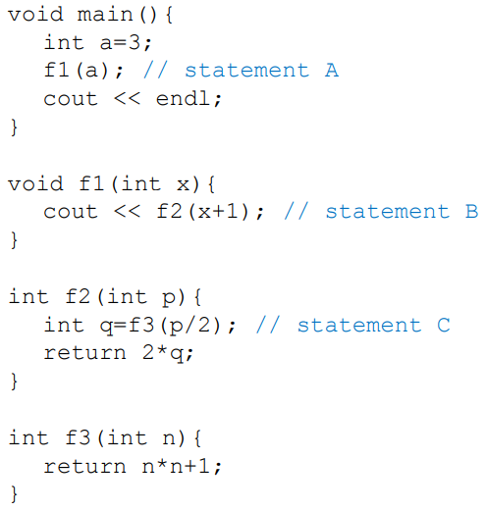
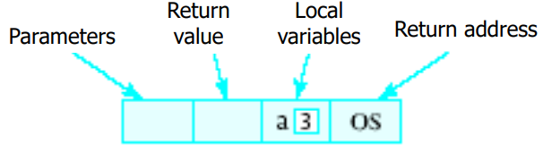
Runtime Stack Example (1)
When a function is called …
Copy of activation record pushed onto run-time stack
Arguments copied into parameter spaces
Control transferred to starting address of body of function
OS denotes that when execution of main() is completed, it returns to the operating system

Slide 12
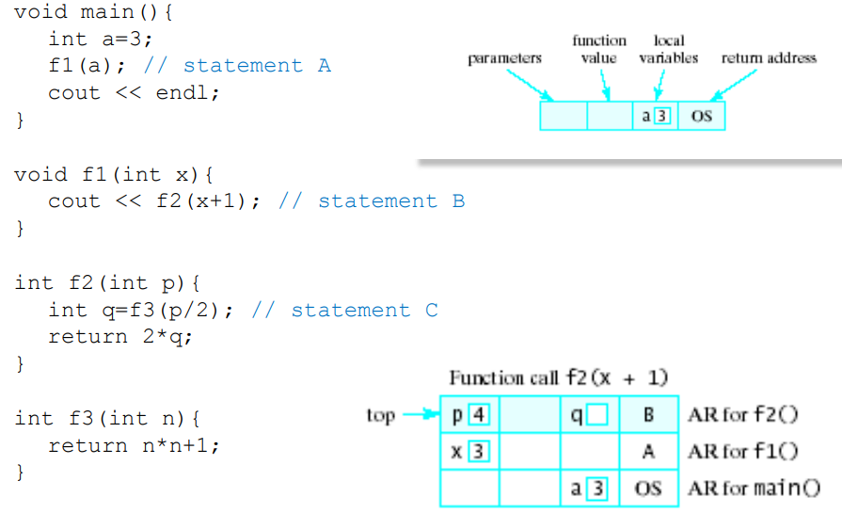
Runtime Stack Example (2)

Slide 13
Static and Dynamic Stacks
Two possible implementations of stack data structure
Static, i.e., fixed size implementation using arrays
Dynamic implementation using linked list

Slide 14
Array-based Implementation

Slide 15
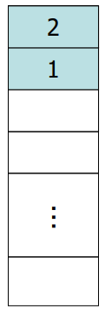
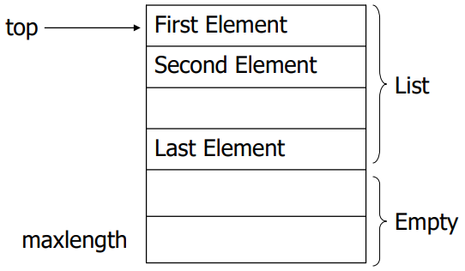
Array Implementation – First Solution (1)
Elements are stored in contiguous cells of an array
New elements can be inserted to the top of the list
Problem: Every PUSH and POP requires moving the entire array up and down

Slide 16
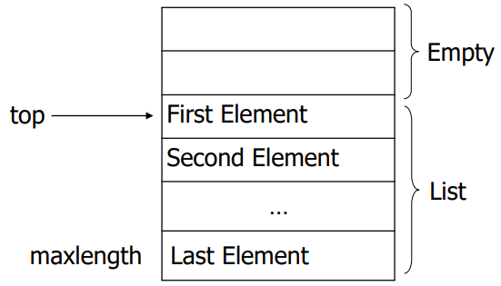
Array Implementation – Better Solution (1)
Idea
Anchor the bottom of the stack at the bottom of the array
Let the stack grow towards the top of the array
Top indicates the current position of the first stack element

Slide 17
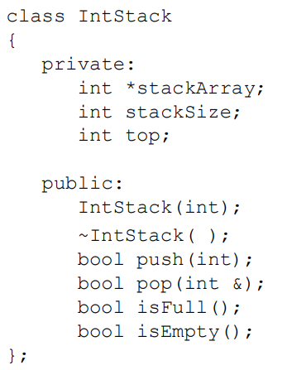
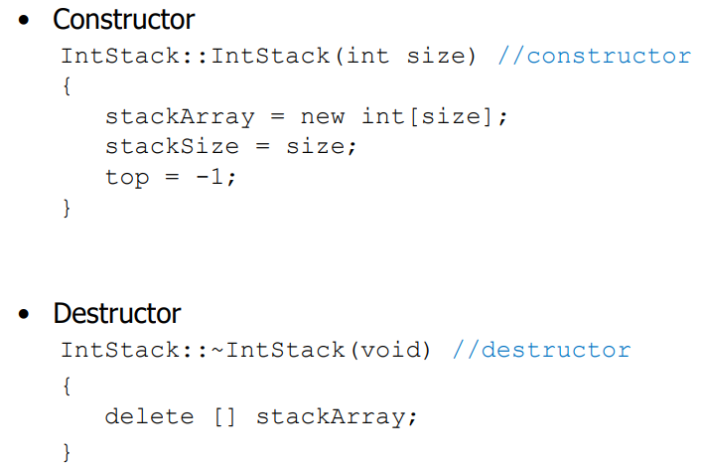
Array Implementation – Code (1)

Slide 18
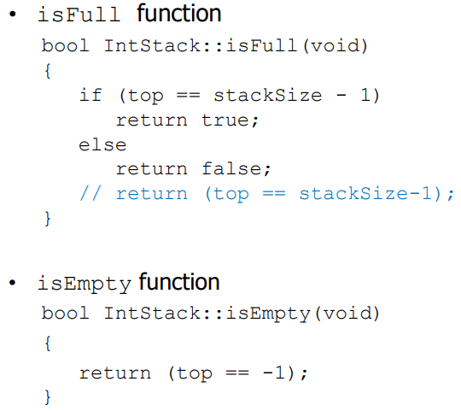
Array Implementation – Code (2)

Slide 19
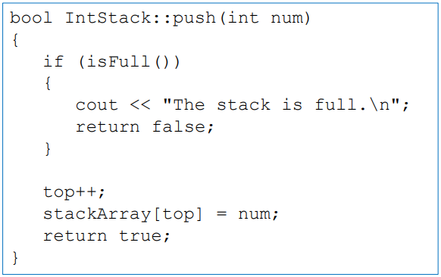
Array Implementation – Code (3)
push function inserts the argument num onto the stack

Slide 20
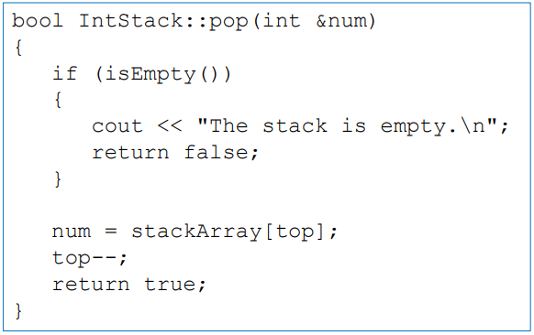
Array Implementation – Code (4)
Pop function removes the value from top of the stack and returns it as a reference

Slide 21
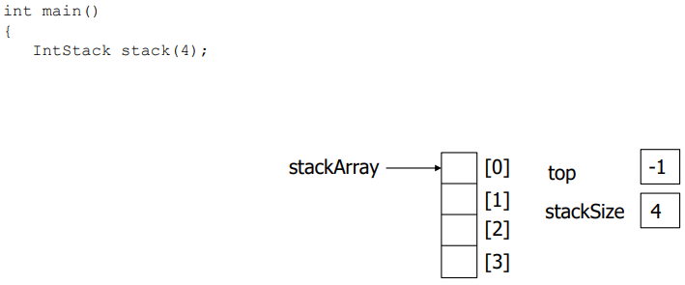
Using Stack (1)

Slide 22
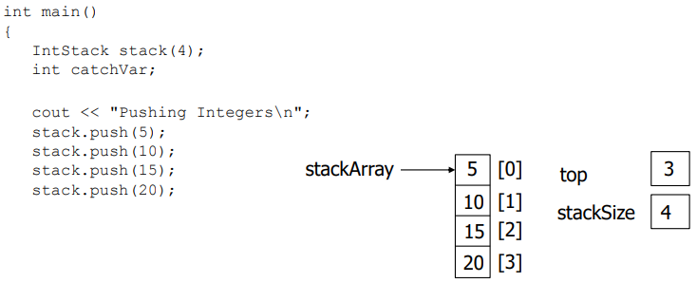
Using Stack (2)

Slide 23
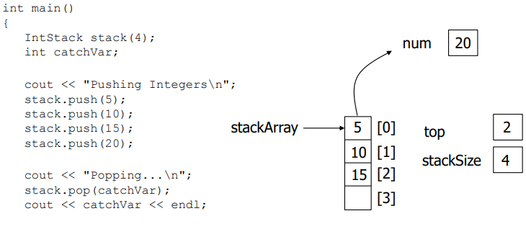
Using Stack (3)

Slide 24
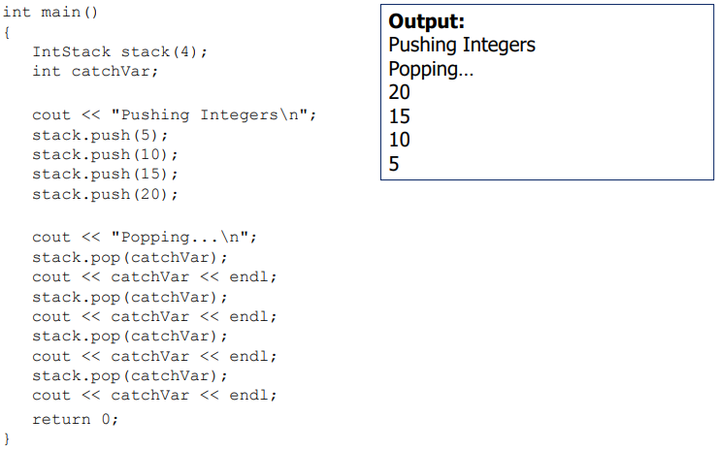
Using Stack (4)

Slide 25
Pointer-based Implementation

Slide 26

Pointer-based Implementation of Stacks
Stack can expand or shrink with each push or pop operation
Push and pop operate only on the head node, i.e., the first node of the list

Slide 27
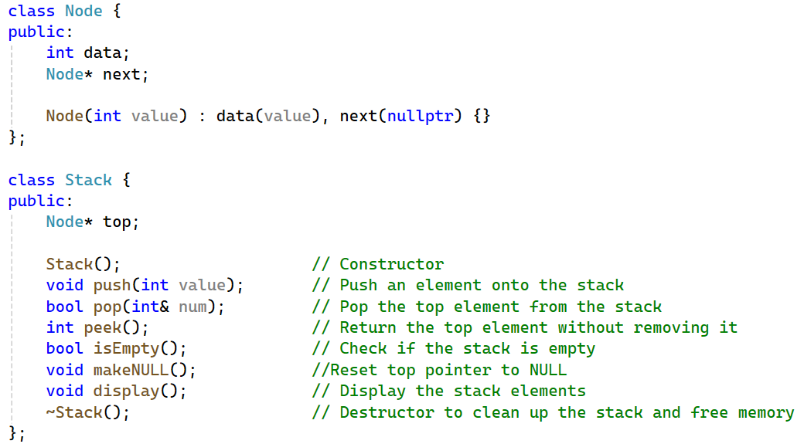
Pointer Implementation – Code (1)

Slide 28
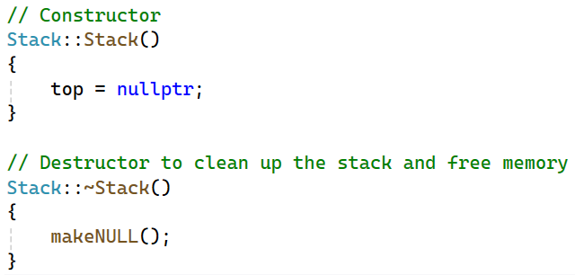
Pointer Implementation – Code (2)

Slide 29
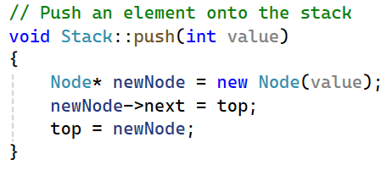
Pointer Implementation – Code (3)
Push function inserts a node at the top/head of the stack

Slide 30
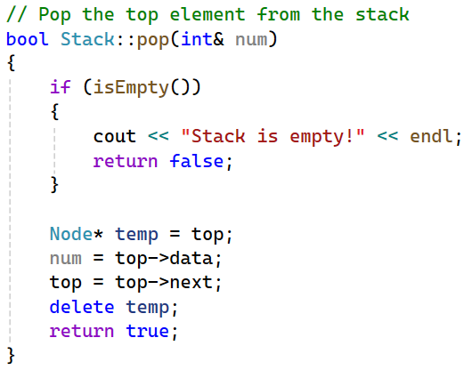
Pointer Implementation – Code (4)
Pop function deletes the node from the top of the stack and returns its data by reference

Slide 31
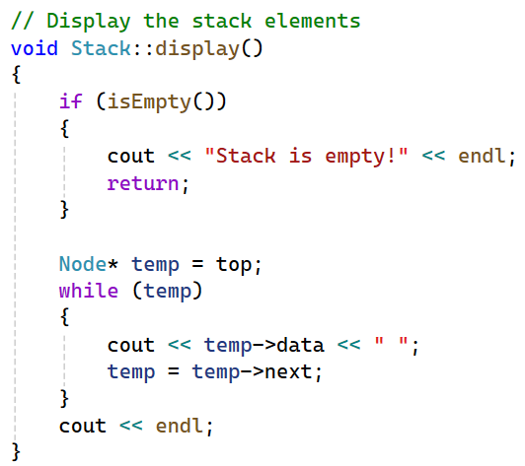
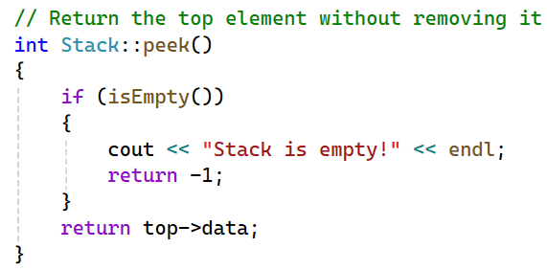
Pointer Implementation – Code (5)

Slide 32
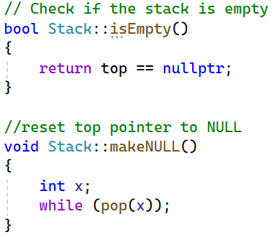
Pointer Implementation – Code (6)

Slide 33
Any Questions?

